Slide 1
PM REVIEW
G3 – T2
Brittany Goh
Chen Bihuang
Tan Ming Sheng
David Liu
Chng Zheng Ren

Slide 2
FUNCTIONALITIES
Do not plan to add / drop any functionality
Model-View-Controller (MVC), JSP Access Model 2
Easier to review/check for errors
Easier to split workload among the 2 pair programmers
Notes:
Controller controls logic

Slide 3
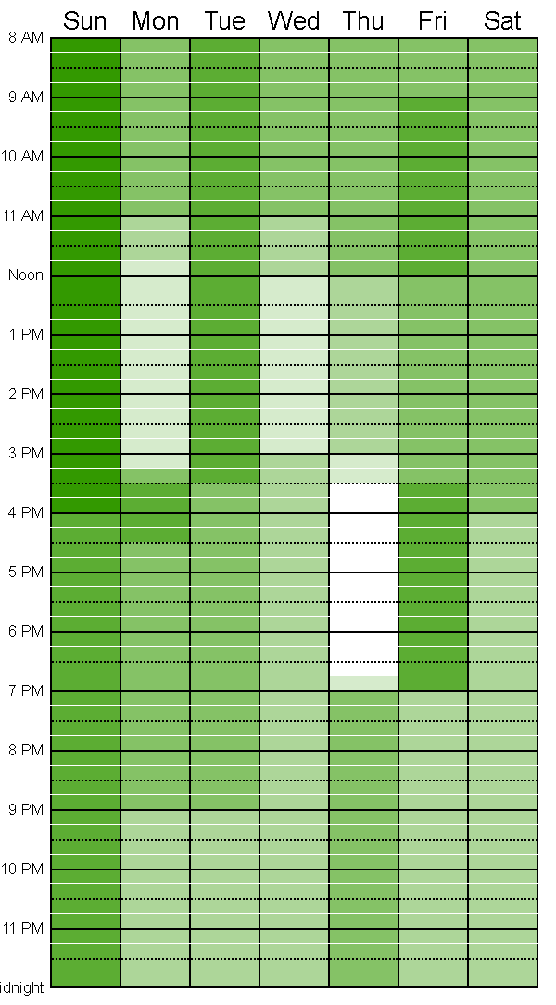
SCHEDULE
Follows Iterative Process
Preparation
Designing slides / documenting metrics
Design
Write Pseudocode
Collaborative checking of pseudocode
Designing classes, UI
Updating of diagrams
Coding
Writing code
Producing test data and cases
Testing + Integration
Single functionality testing run
Single functionality debugging
Regression Testing/Debugging
Deployment
Deployment of application
Debugging Deployment
Hand over / PM activities
Update of documents
7 Iterations:
14 days per iteration (2 weeks)
Start: Monday
End: Sunday
Time boxing
Group meets on Sundays every week
Time Boxing
Fixed time, change tasks within iteration
Plan to complete all functionalities by Iteration 5, Week 10

Slide 4
SCHEDULE - OVERVIEW
Week 2-3
Creating shared resources
Week 10-11
UAT Debugging Sessions
Week 12-13
Preparation for final presentation
Week 4-5
Week 6-7
Heatmap
Week 8-9
Bootstrap Update
Download/ install tools
Initial design of documents
Start Basic Location Report
Login Forms
Automatic Group Detection
JSON Login
Buffer
1
2
3
4
5
6
PM REVIEW
App Demo & Progress Update
UAT
Final Presentation

Slide 5
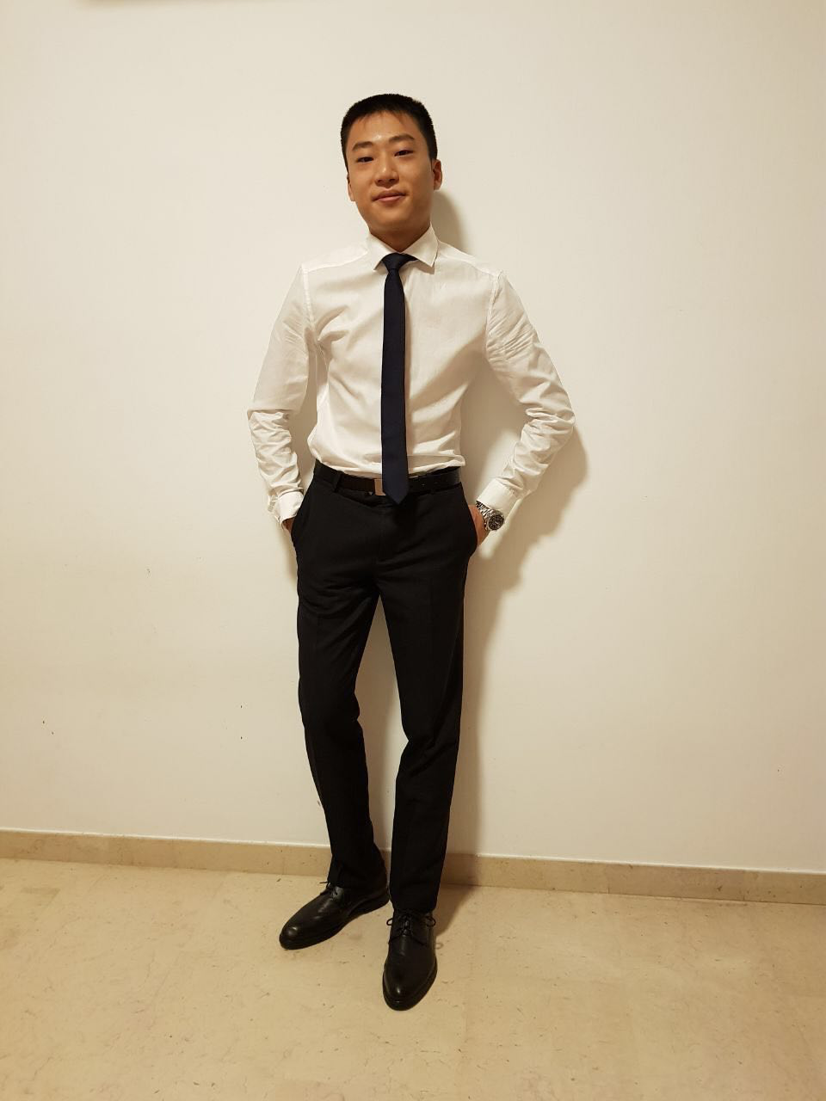
ROLES
Minutes Taker:
Brittany
Iteration 1
Start Date: 1/9/2017
End Date: 10/9/2017
Minutes Taker: Brittany
TASK | MEMBER ALLOCATION
Creating shared resources | Everyone (During meeting)
Download/Install tools | Everyone
Initial design of diagrams Use Case Sequence Class Logical | Everyone (During meeting)
PM: COLIN

Slide 6
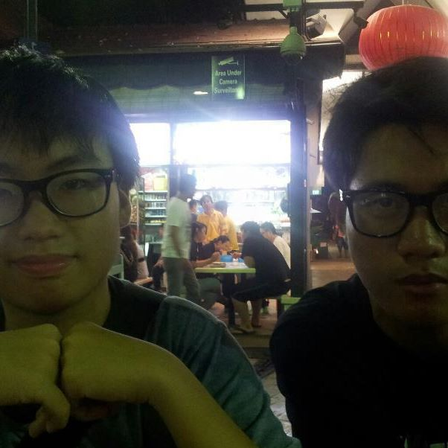
Iteration 2
Start Date: 11/9/2017
End Date: 23/9/2017
Minutes Taker: Christopher
TASK | MEMBER ALLOCATION
Design (Technical Documents) Class Diagrams Sequence Diagrams (Login, Bootstrap) | Zheng Ren Zheng Ren
Programming Database creation Login Function JDBC Connection Java Entity, DAO packages Validation Bootstrap create | Chris, Colin Chris, Colin David, Brit David, Brit David, Brit David, Brit
Test Cases Login Bootstrap | Chris Zheng Ren, Colin
Planning, Updates, Admin | Everyone
PM: ZHENGREN

Slide 7
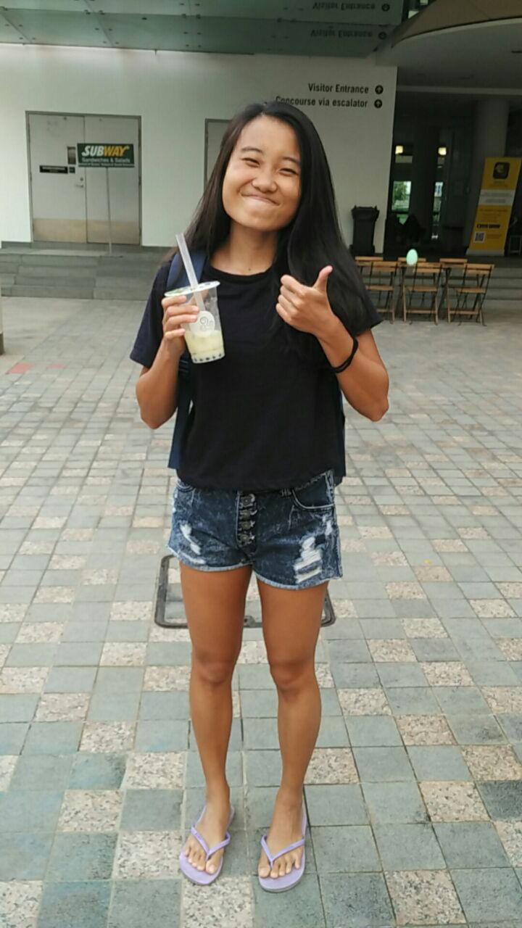
Iteration 3
Start Date: 24/9/2017
End Date: 8/10/2017
Minutes Taker: David
TASK | MEMBER ALLOCATION
Design (Technical Documents) SD (Login, Heatmap, BLR) | Britt
Programming Top K Companions Breakdown by year and gender Top K Popular Places UI (Login, Home, Form pages) Top K next places | Chris, David Chris, David Colin, Zheng Ren Colin, Zheng Ren Colin, Zheng Ren
Test Cases Breakdown by year and gender Top K popular places Top K companions Top K next places | David David Chris Chris
Planning, Updates, Admin PM Review Slides | Everyone Britt
PM: BRITTANY

Slide 8

Iteration 4
Start Date: 9/10/2017
End Date: 22/10/2017
Minutes Taker: Colin
TASK | MEMBER ALLOCATION
Design (Technical Documents) Update Diagrams
Programming Heatmap Automatic Group Detection
Test Cases Heatmap Automatic Group Detection
Planning, Updates, Admin Demo Preparation | Everyone
PM: DAVID

Slide 9
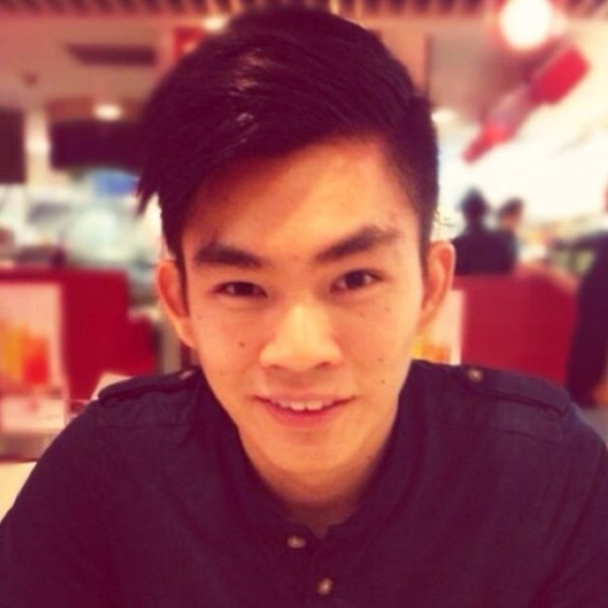
Iteration 5
Start Date: 23/10/2017
End Date: 5/11/2017
Minutes Taker: Zheng Ren
TASK | MEMBER ALLOCATION
Programming Bootstrap Update JSON Login Debugging
Test Cases Heatmap Automatic Group Detection Regression Testing
Planning, Updates, Admin Prepare for UAT | Everyone
PM: CHRISTOPHER

Slide 10
Iteration 6
Start Date: 6/11/2017
End Date: 19/11/2017
Minutes Taker: Brittany
TASK | MEMBER ALLOCATION
Programming UAT Debugging Cleaning up codes
Test Cases Regression Testing
Planning, Updates, Admin Prepare for final submission | Everyone
PM: COLIN

Slide 11
ROLES
Minutes Taker:
Brittany
Iteration 7
Start Date: 20/11/2017
End Date: 26/11/2017
Minutes Taker: Chris
TASK | MEMBER ALLOCATION
Planning, Updates, Admin Prepare for final presentation | Everyone
PM: COLIN

Slide 12
CRITICAL PATH – Iteration 1
(8 days)
Design:
Database,
Use Case,
Logical,
Validation class for Bootstrap
(1 day)
Project Discussion
Shared Resources
Knowledge Sharing
Install Programs
(1 day)
Meeting + Design
(1 day)
(8 days)
Project Critical Path
(1 day)

Slide 13
CRITICAL PATH – Iteration 2
Update
Diagrams
(1 day)
(4 days)
Database
creation +
Login Function
(1 day)
(1 day)
Design + Planning
(0 day)
(1 day)
Test data
+ cases:
Bootstrap,
Login
(1 day)
(2 days)
Group
Meeting
(1 day)
(1 day)
Bootstrap
(2 days)
(1 day)
Testing/
Debugging:
Bootstrap
(1 day)
(1 day)
Meeting
+ Design + Prep PM
Review
(1 day)
Testing/
Debugging:
Login
(1 day)
(2 days)
Pseudocode:
Breakdown by
year/gender
Top K Popular Places
Top K Companions
Top K Next Places
(1 day)
JDBC
Connection , Entity, DAO
Package
(1 day)
Validation, Bootstrap–
Admin
(1 day)

Slide 14
CRITICAL PATH – Iteration 3
BLR:
Top K
Comp.
(1 day)
BLR:
Top K Pop.
Places
(1 day)
BLR:
Breakdown
by
year/
gender
(1 day)
BLR:
Top K
Next
places
(1 day)
(3 days)
Deploy to
AWS +
Debugging
(1 day)
Design + Planning
(0 day)
(1 day)
PM
Review
slides
(1 day)
(1 day)
Test data
+ Cases:
Breakdown,
Top K
Popular
places
(1 day)
(1day)
Group
Meeting
(1 day)
Test data +
Cases: BLR
Top K Comp.
Top K next
places
(1 day)
PM
Review Slides
(1 day)
(4 days)
Meeting,
Design,
Metrics
(1 day)
UI – Login,
Home,
Form pages:
BLR,
Bootstrap
(1 day)
Update Sequence Diagrams
(1 day)
(1day)
Pseudo
Code:
Heatmap
(1 day)
(2 days)
Pseudo
Code: AGD
(1 day)
Testing/
Debugging:
BLR
(1 day)

Slide 15
CRITICAL PATH – Iteration 4
AGD
(4 days)
Heatmap
Debugging +
Regression
Test
(1 day)
Design + Planning
(0 day)
Update
Java Docs
Update
diagrams
(1 day)
(1 day)
Group
Meeting
(1 day)
Test data +
Cases:
AGD Heatmap
(1 day)
PseudoCode:
Bootstrap
Update
JSON Login
(1 day)
(1 day)
Deployment
to AWS +
Debugging
(2 days)
Meeting,
Design,
Metrics,
Demo Prep
(1 day)
Heatmap
(4 days)
AGD
Debugging +
Regression
Test
(1 day)

Slide 16
CRITICAL PATH – Iteration 5
Bootstrap
Update
(2 days)
Test data +
Cases:
Bootstrap
JSON Login
(1 day)
Bootstrap,
JSON Login: Debugging +
Regression Test,
(2 day)
AWS
Deployment&
Debugging
(1 day)
Group
Meeting
(1 day)
(6 days)
Meeting
(1 day)
JSON
Login
(2 days)

Slide 17
CRITICAL PATH – Iteration 6
Regression
Testing
(3 days)
(2 days)
(1 day)
Group
Meeting
(1 day)
(6 days)
Meeting
(1 day)
UAT
Debugging
(4 days)
AWS
Deployment
(1 day)

Slide 18
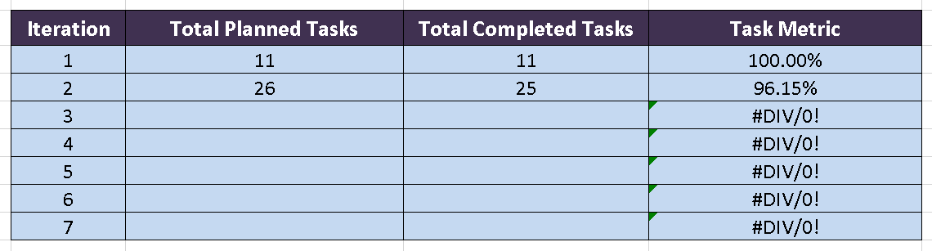
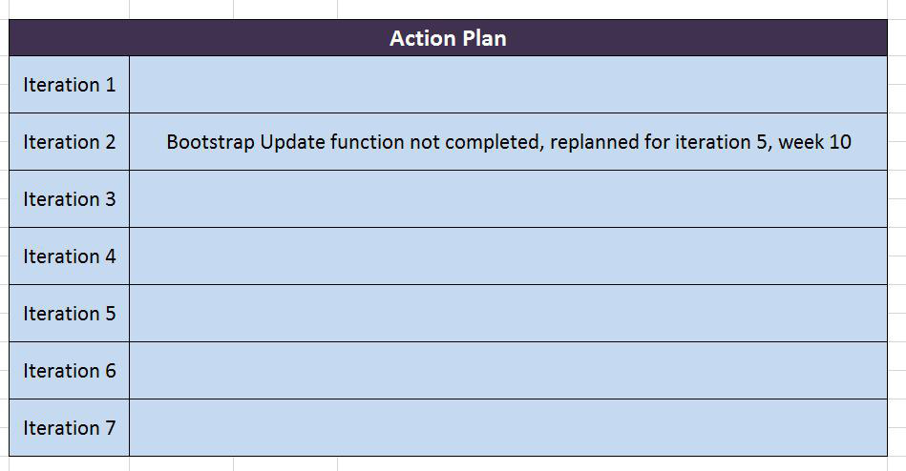
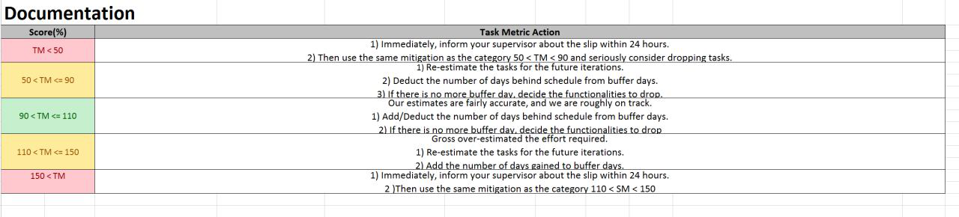
METRICS – TASK
Notes:
Re-plan according to Mitigation plan

Slide 19
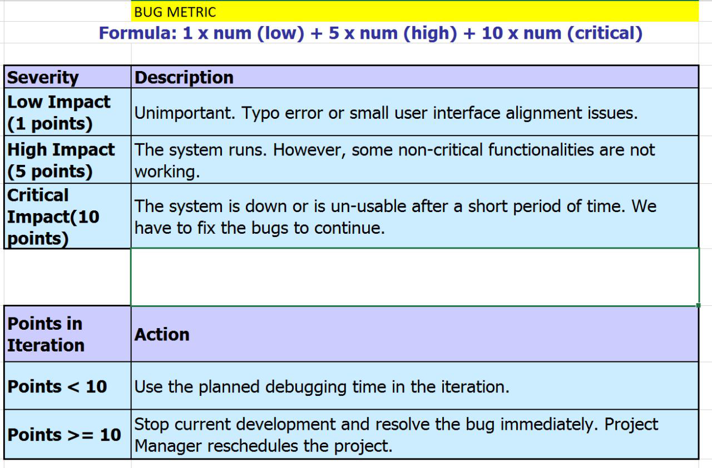
METRICS – BUG

Slide 20
ROLES & RESPONSIBILITIES
Project Manager
Update Project Schedule
Remind team of all deadlines
Updates Task Metrics
Pair Programming Teams
Navigator
Review code
Driver
CODE
Navigator and Driver switch roles every 30 minutes or less
Minutes Taker
Changed every iteration
Takes meeting minutes

Slide 21
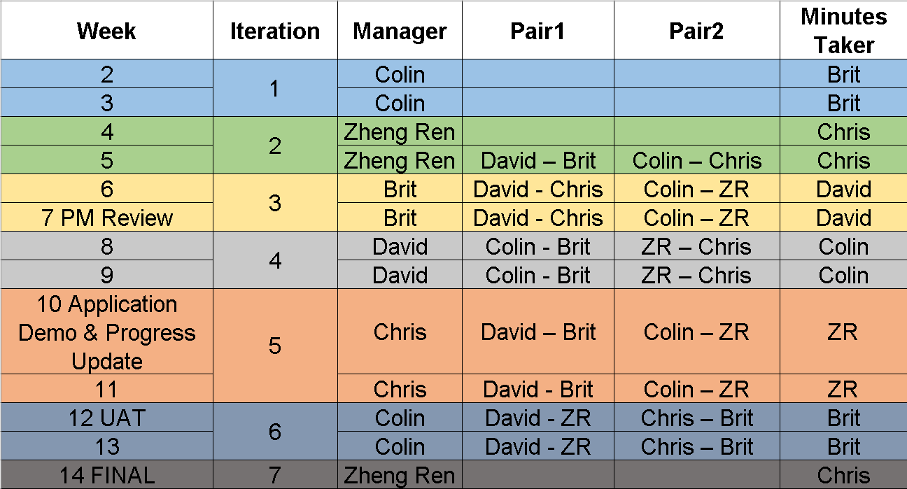
ROLE ROTATION PLAN

Slide 22
QUESTIONS
THANK YOU

